Slide 1
The Cultural Revolution of China
1966-1976
Chairman Mao Zedong

Slide 2
Mao’s Realistic Intentions
Rebel Against:
old thoughts
old culture
Intellectuals
Old customs

Slide 3
The Young Rebels
Red Guards-students who attacked, even killed:
Teachers-they were the first target
Landowners
Factory Managers
Politicans

Slide 4
Mao’s Young, Red Guard
The Red Guard destroys:
All remembrance of old Chines culture
Students turn against teachers and the administration
Local property owners
Authority figures
Mao insists that The Red Guard turn against anyone who gets in their way…
Even their own parents!

Slide 5
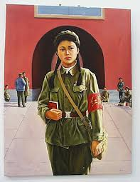
A Female Red Guard

Slide 6
Mao’s Little Red Book
Little Red Book of Citations:
Translated into 39 languages and 3.9 billion copies circulated in China
Don’t try to think, believe in Chairman Mao blindly
This book is essential in all walks of life
Try to disobey, an overseer will tear off your dog’s head!

Slide 7
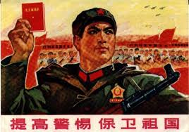
Mao’s Little Red Book

Slide 8
Impact of the Little Red Book
This book was an attempt to distract ordinary Chinese citizens to notice what is really happening
Reading other books were forbidden
Chairman Mao: the more different books you read, the more stupid you become
Mao ruled Communist China with an iron fist

Slide 9
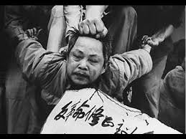
1966-1967 China Descends into Mass Chaos
Artists are targets of the Red Guard as well
Red Guard can beat and torture anyone they want
They break into military bases and steal weapons
Possibly, thousands of instances of cannibalism during this time period

Slide 10
Mao Achieves His Goal
Cultural Revolution winds down in 1969, because he reaches his political goals
Mao disperses the Red Guard, and sends them into rural districts to be peasant farmers

