Slide 1
New World & early americans
Andrea Heading
University High School
Morgantown, WV 26508

Slide 2
Events
Early Americans
Discovery
Conquest
Contact

Slide 3
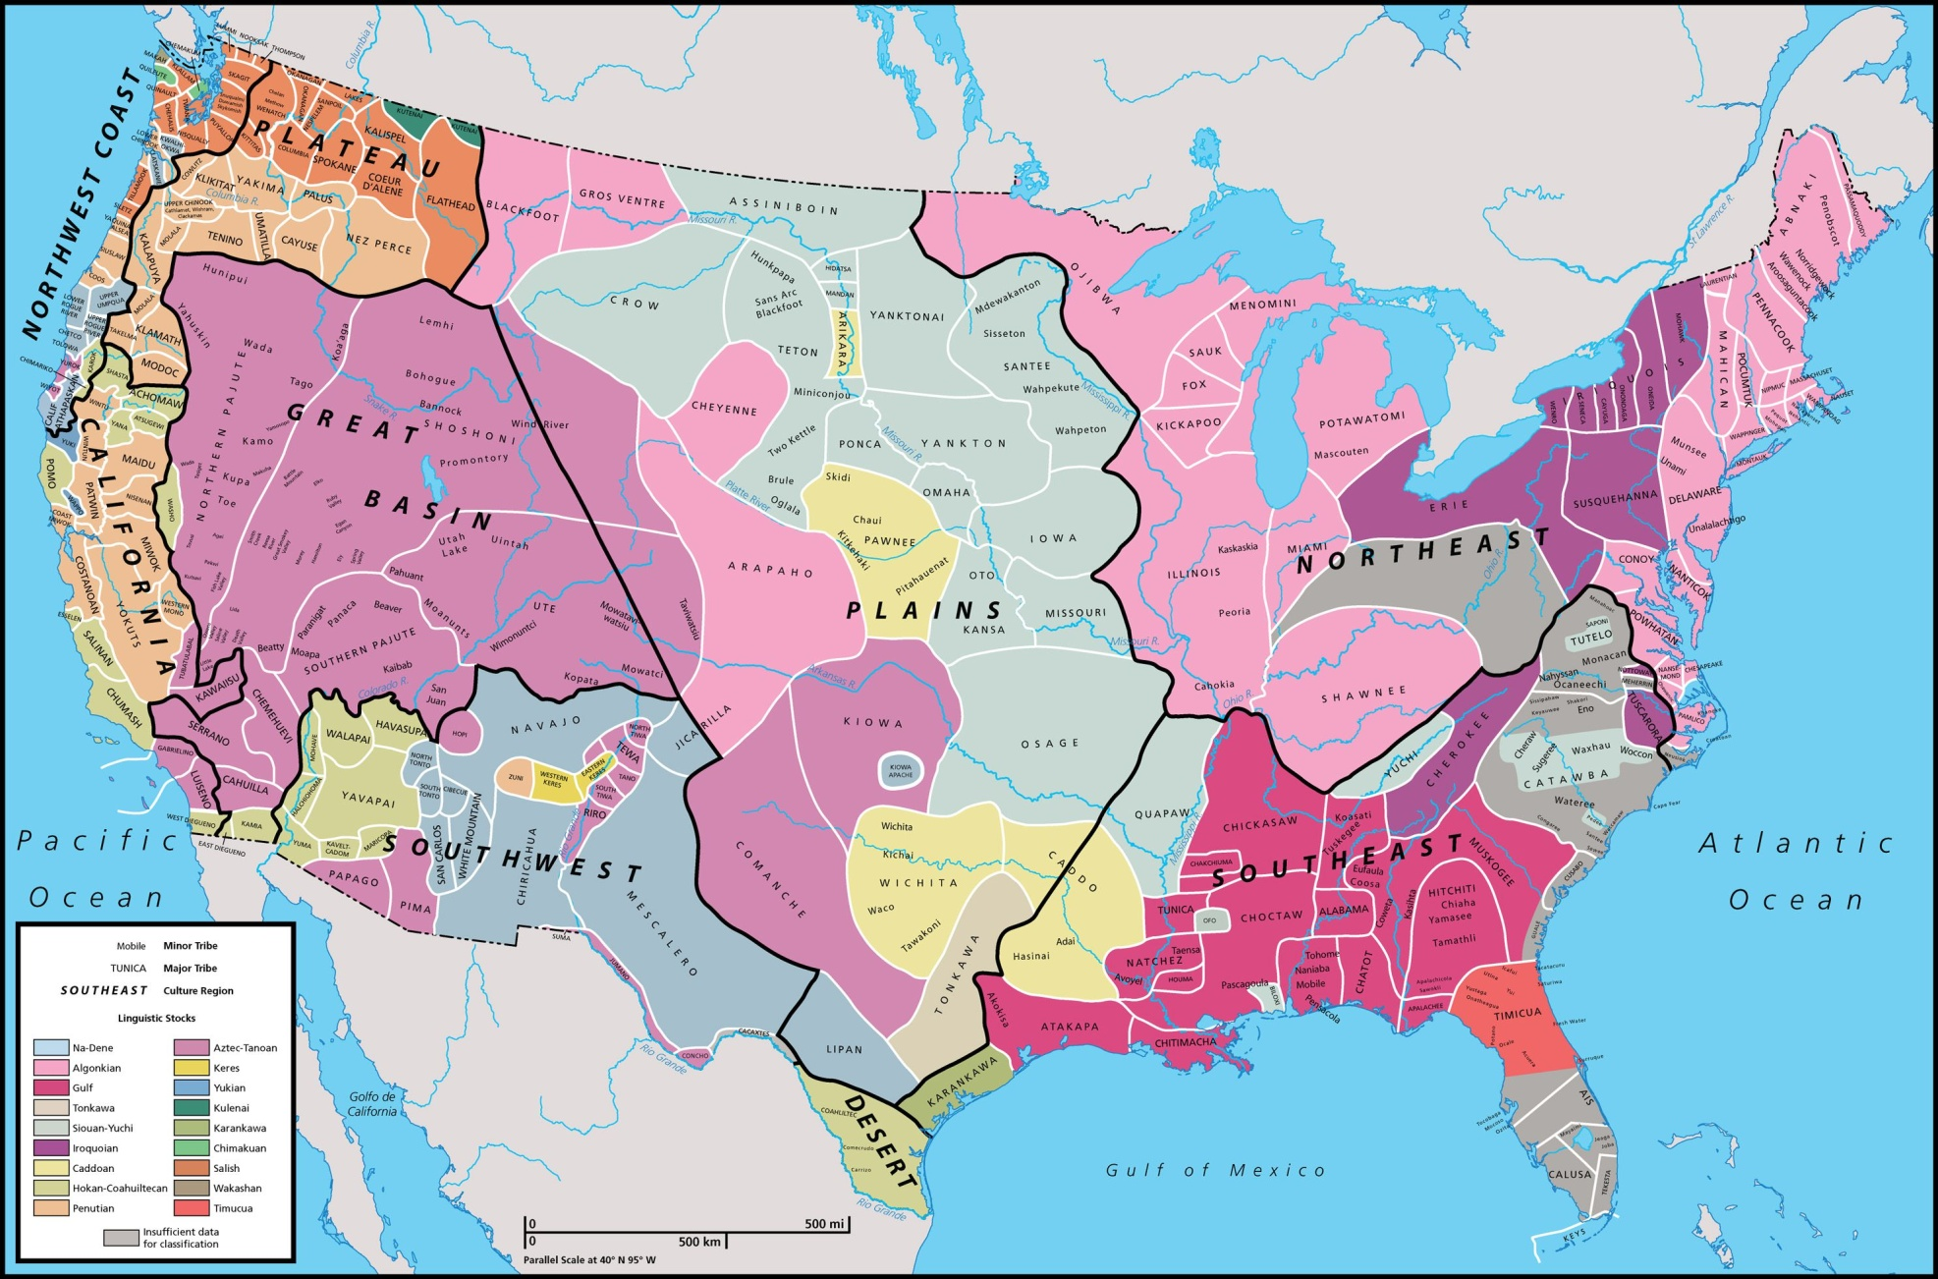
Native american languages & groups (pre 18th century)

Slide 4
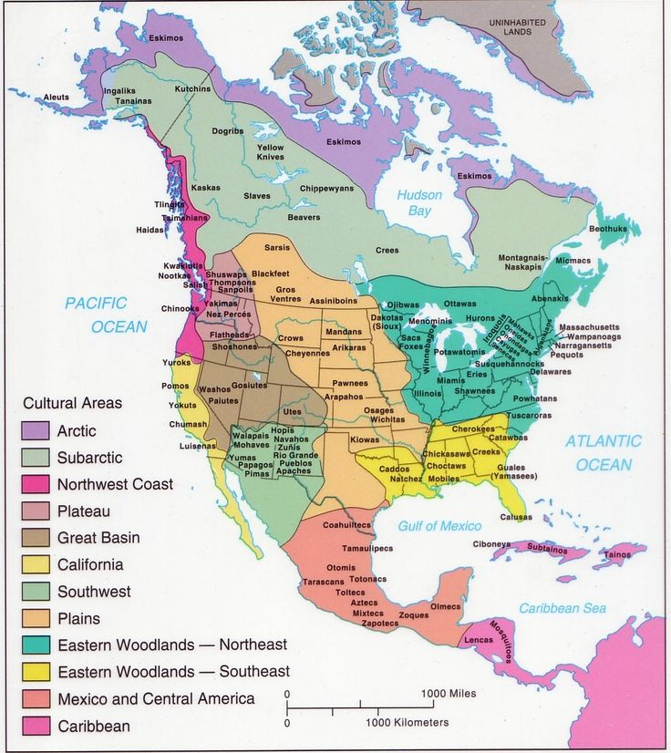

Slide 5
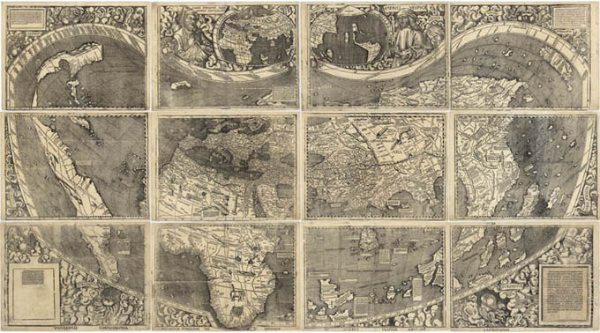
Martin Waldseemüller’s 1507 world map

Slide 6
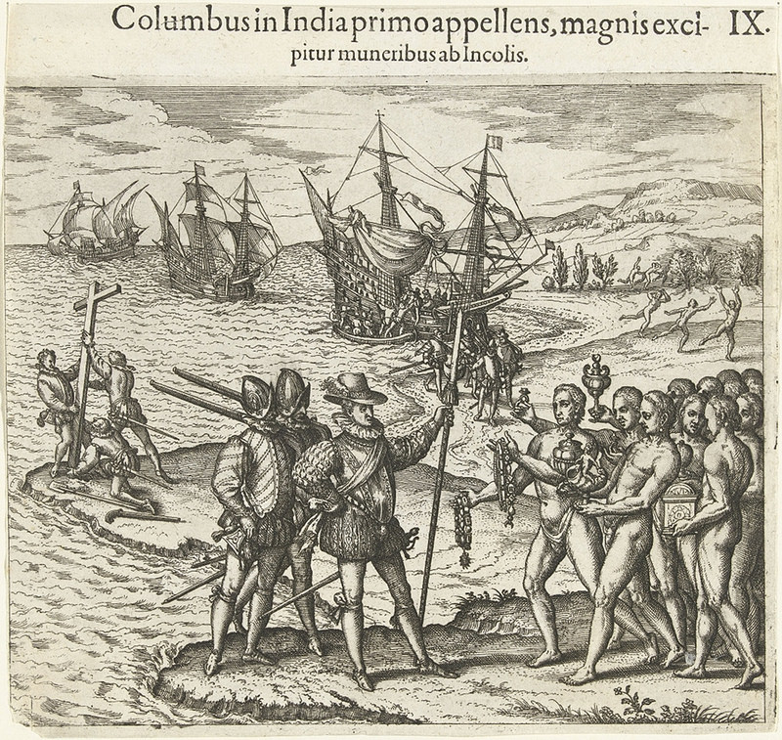
Columbus, as he first arrives in India, is received by the inhabitants and honored with the bestowing of many gifts by Bry, Theodor de, 1528-1598, engraver

Slide 7
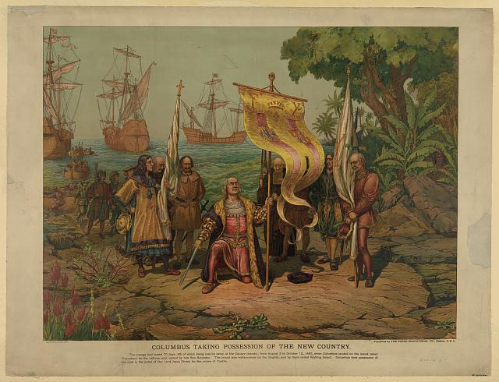
Columbus taking possession of the new country
EXPLORATION

Slide 8
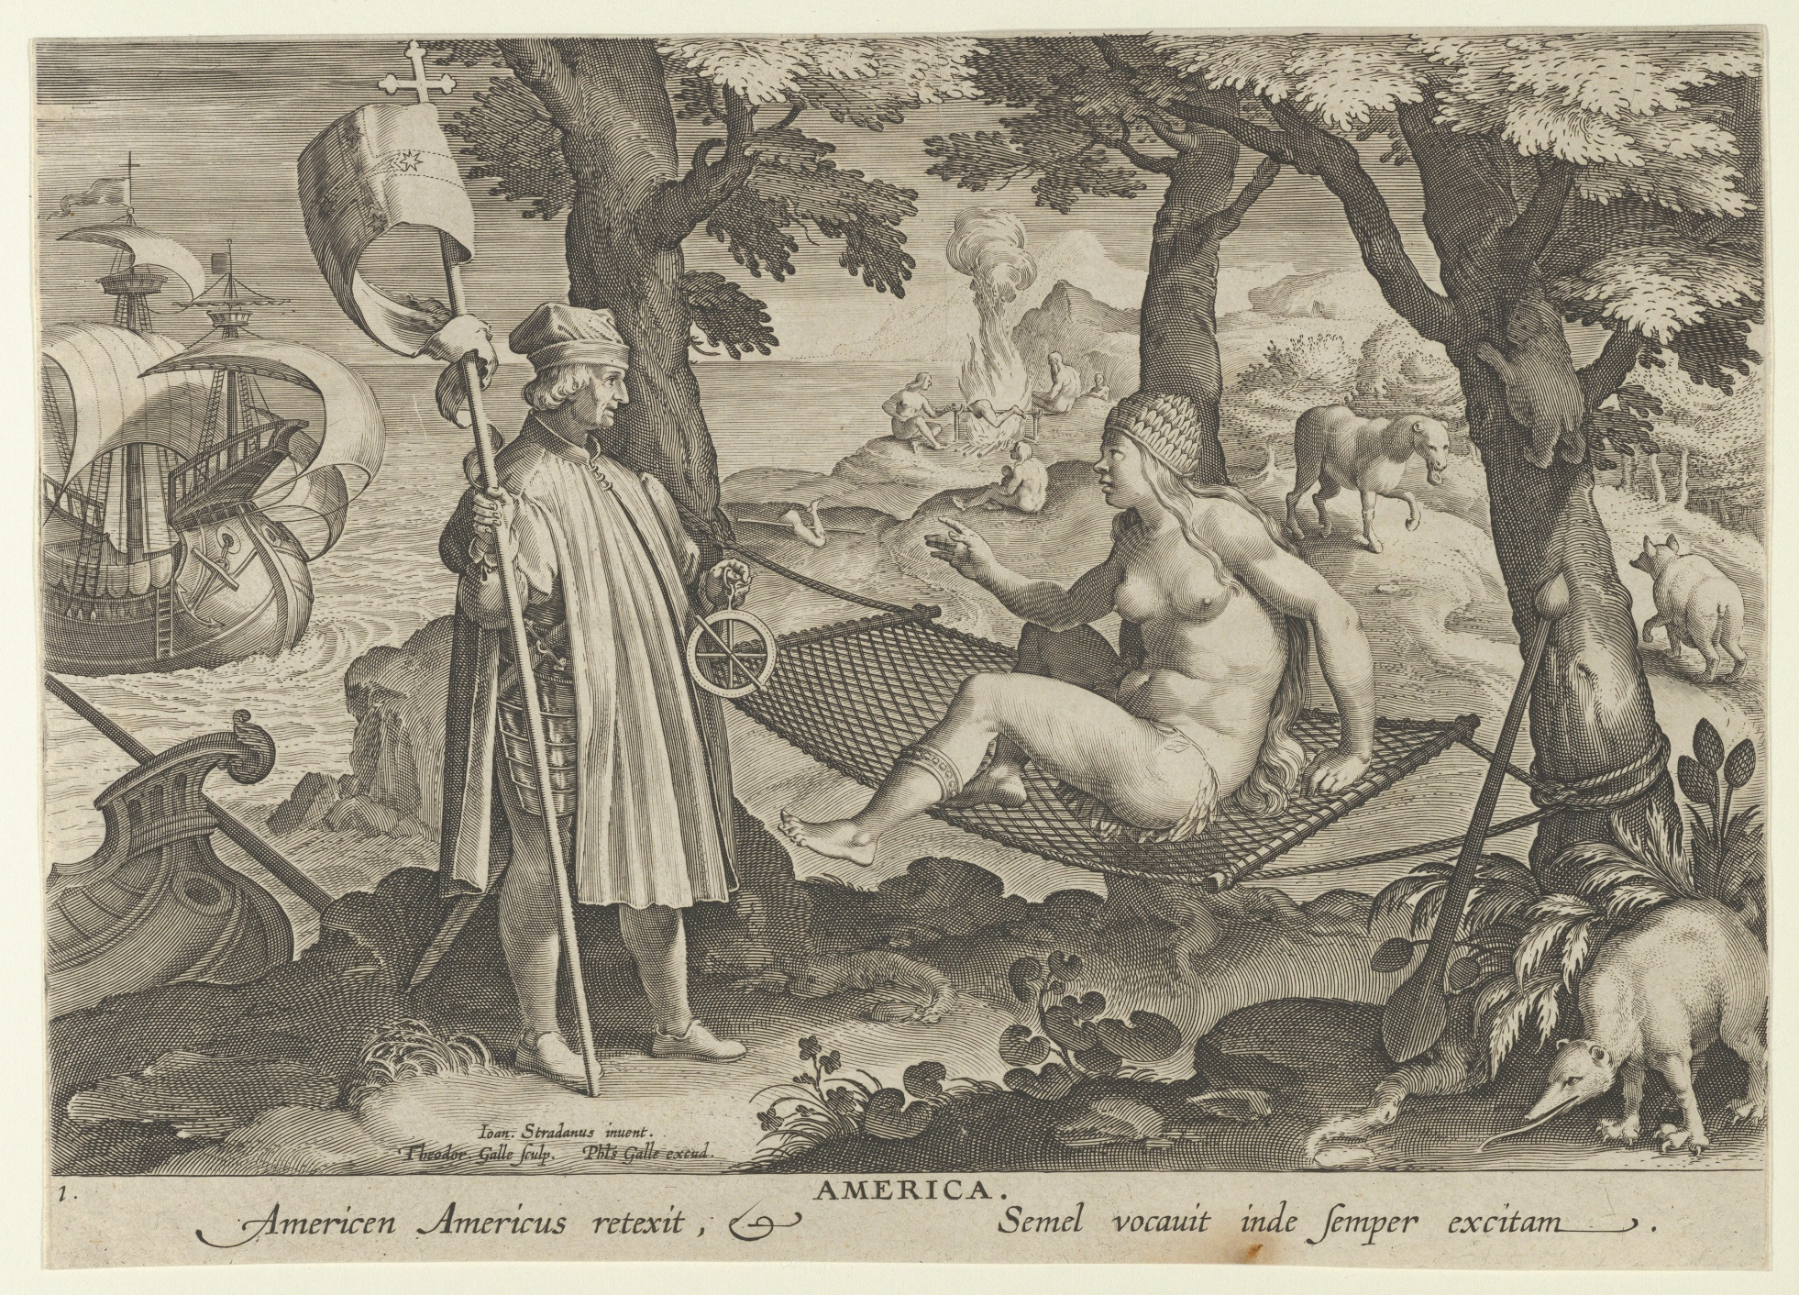
The Discovery of America Theodore Galle

Slide 9
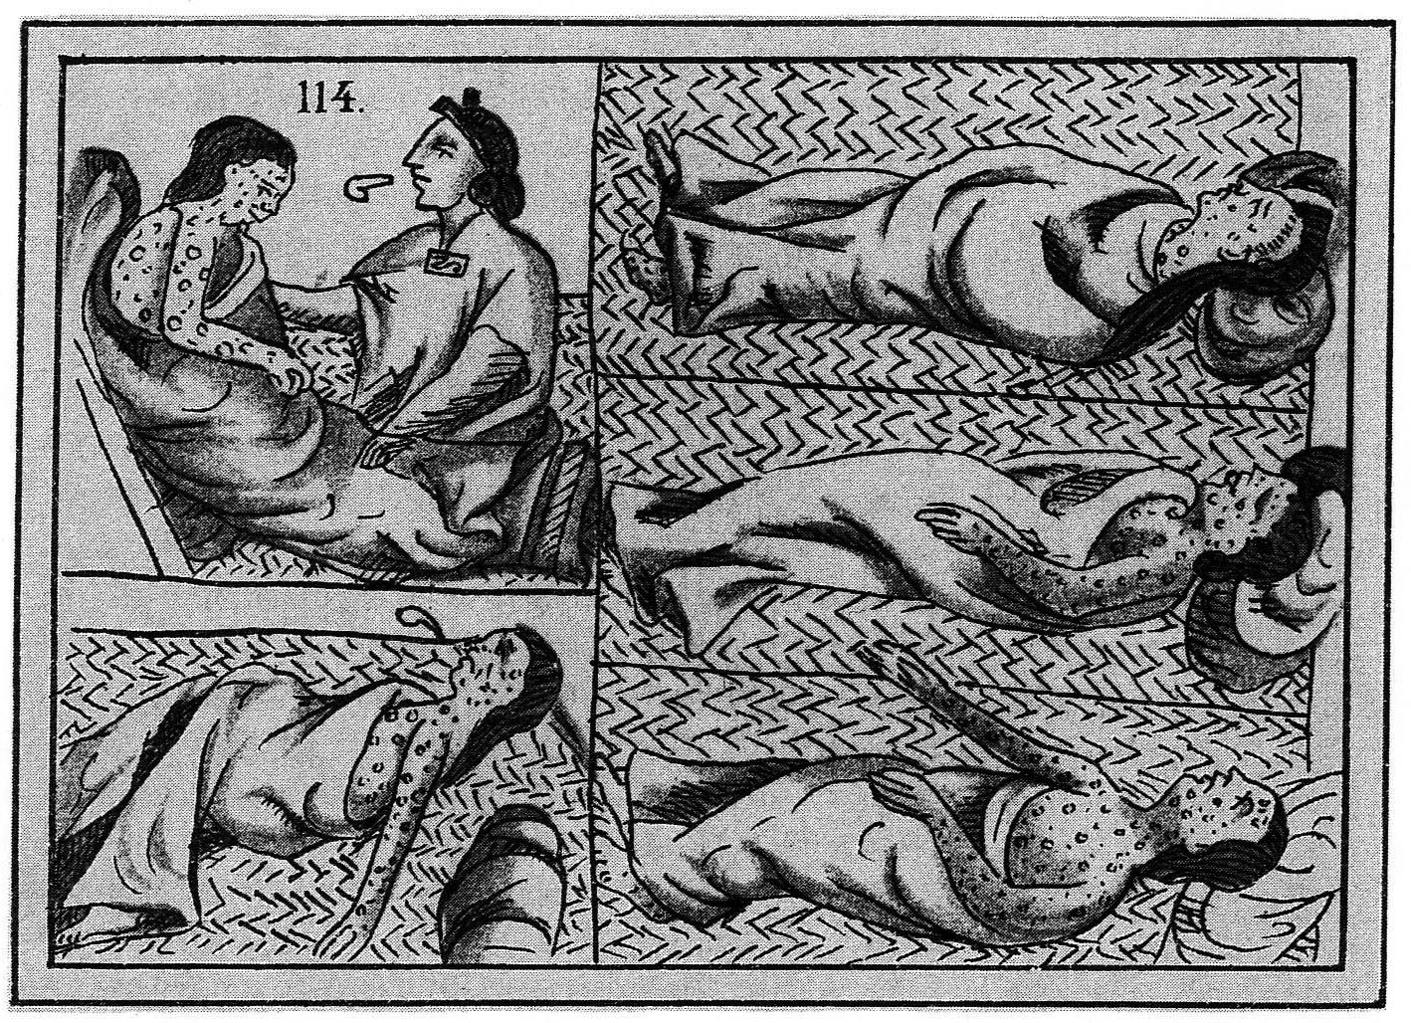
smallpox

Slide 10
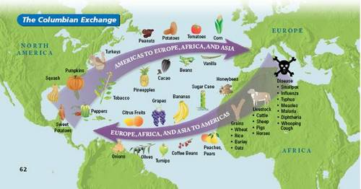
Columbian Exchange

Slide 11
american indians or native americans today
Tribes Today – over 300
Tribal Nations Today – celebrating heritage and passing down culture, discovering real names verses Euro-centric names (maps)

