Slide 1
Territorial and Maritime Disputes
Krista Wiegand
University of Tennessee

Slide 2
Issues Approach
Focus on issues at stake – different issues = different conflict patterns
Does NOT treat all issues the same – territorial disputes are more severe than policy disputes
Within issues, different salience – economic issues (oil) are more easily solved than ethnic issues (nationalism), which are more intractable
Sacred territory, identity, religious value, historic legacy are more intractable
Tangible and intangible value or salience determines intractability of conflict and success of conflict management
Jerusalem – symbolic salience

Slide 3
Territorial Disputes
Most typical type of international dispute
#1 cause of MIDs and wars
Territorial tracts/islands or borders
Land
Borders – disagreement about where border should lie
Islands - challenger state attempts to take territory for defender state
Maritime boundaries

Slide 4
Territorial Disputes
97 territorial disputes settled since 1945
Currently 70 ongoing disputes between states
Middle East & Africa experience most disputes
Well known border and territorial disputes:
Kashmir
Israel-Palestine
Spratly Islands
Falkland Islands
Western Sahara
Not all disputes are MIDs/war
Notes:
(almost 1/3 of the world)

Slide 5
Maritime Disputes
Disputes about definition of maritime features – islands, rocks, shoals, reefs
Legal access to territorial waters, EEZ, continental shelf
UNCLOS – “constitution of the sea”
ITLOS, arbitration, negotiations – ongoing disputes
South China Sea dispute

Slide 7
Dividing Land by Identity
Secession: attempt by national group to achieve new statehood by taking territory of the status quo state (Palestine, Chechnya)
Irredentism: attempt by national group to join neighboring state by taking territory of the status quo state (Catholics in Northern Ireland)
Independence movements, self-determination
Partition – India/Pakistan-Bangladesh – debated success

Slide 8
Endurance of Territorial & Maritime Disputes
Difficult to resolve certain types of disputes
Nationalist, ethnic, religious identity – highly intractable
Disputes can be used for bargaining leverage purposes
Very costly – interference in diplomatic relations, trade relations, inability to access natural resources, insecure borders, high tensions, security dilemma, arms buildups

Slide 9
Armed Conflict in Territorial Disputes
Strategic value, nationalist/ethnic value
Contiguity
Rivalry
Military power parity
Non-democratic dyads
“Steps to war” - Vasquez

Slide 10
Steps to War - Vasquez
Paths to war, typical factors that build on each other
Territorial dispute is at core of explanation
Based on issues approach in conflict processes
Each step increases threat perception, stubbornness, etc.
The more factors, the more escalatory conflict becomes

Slide 11
Steps to War
Territory (.24)
Territory + Rivalry
Territory + Alliances
Territory + Rivalry + Alliances
Territory + Arms Races
Territory + Rivalry + Arms Races
Territory + Alliances + Arms Races
Territory + Rivalry + Alliances + Arms Races (.63)

Slide 12
Resolving Territorial & Maritime Disputes
Conflict management
Different types of conflict management – negotiations, mediation, arbitration, adjudication – ICJ
Different factors influence strategy of conflict management
Patterns examined by research helps disputants figure out which are the best methods of peaceful resolution

Slide 13
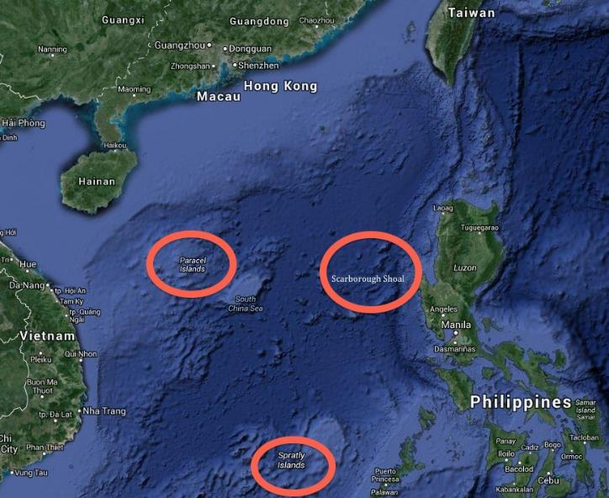
Notes:
For a long time the little islands, shoals, reefs and rocks of the Paracel and Spratly Islands in the South China Sea were regarded as little more than hazards of navigation, especially since they had no apparent value. Over time, with the discovery of oil reserves and billions of dollars’ worth of fisheries, the previously ignored features in this large maritime area gained significant attention from these countries, particularly China.

Slide 14
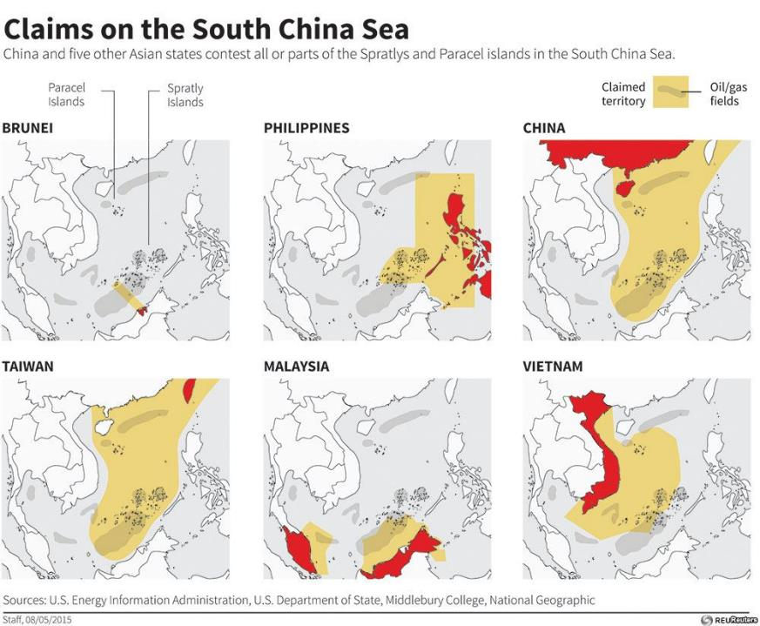
Notes:
The countries involved are China, the Philippines, Vietnam, Malaysia, Brunei, and Taiwan, and purely maritime issues with Indonesia.

Slide 15
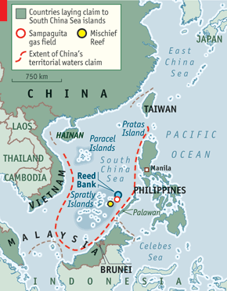
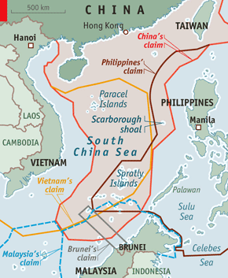
Notes:
Following China’s 2009 declaration of the “U-shaped line” in a notes verbale sent to the United Nations that included a map depicting the line as it applied to their claims in the South China Sea, China has aggressively taken control over a number of these disputed islands, shoals, and reefs, particularly Reed Bank in March 2011 and Scarborough Shoal in April 2012, when China seized control of Philippine maritime areas.

Slide 16
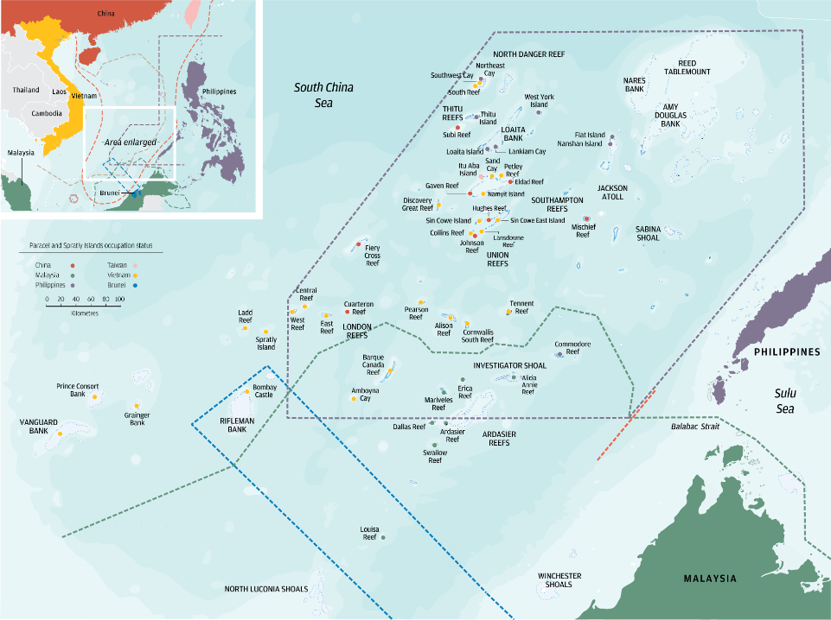
Notes:
The dispute arose from a differing interpretation of history, different interpretations of UNCLOS, an unwillingness by China to settle the dispute via legal dispute settlement procedures, and the inability of the countries involved to negotiate between themselves.
China bases its claims on historic documents that they argue show the disputed area as being under their administrative control for centuries.
The Philippine claim is based on their historical exploration in the area during the 1940s and 1950s, formalized in 1972 when the Philippine legislature formally designated some 53 islands and shoals from the Spratly Islands chain as part of Palawan Province.

Slide 17
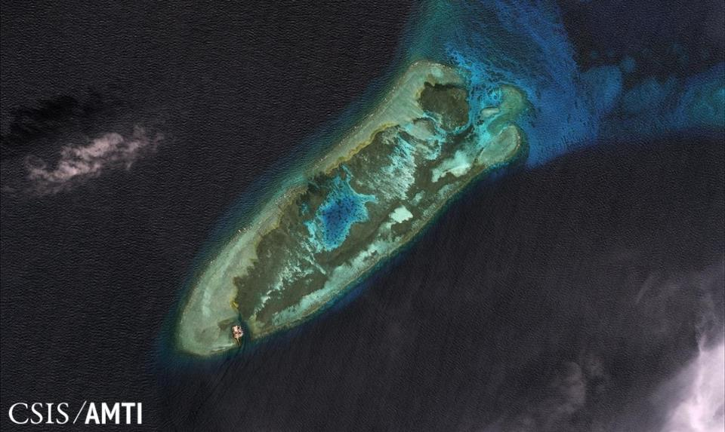
Notes:
China’s strategy has been to occupy reefs and shoals and build artificial islands with military installations, accelerating construction in recent years. In the Chinese perspective, as a regional major power and country that is expanding its power projection to counter U.S. military presence in East Asian maritime areas, this is part of the strategy to fulfill control of the area up to the First Island Chain, as well as to gain control of territorial seas, expanding Chinese EEZ access.
As an illustration, this is Fiery Cross Reef in January 2006.

Slide 18
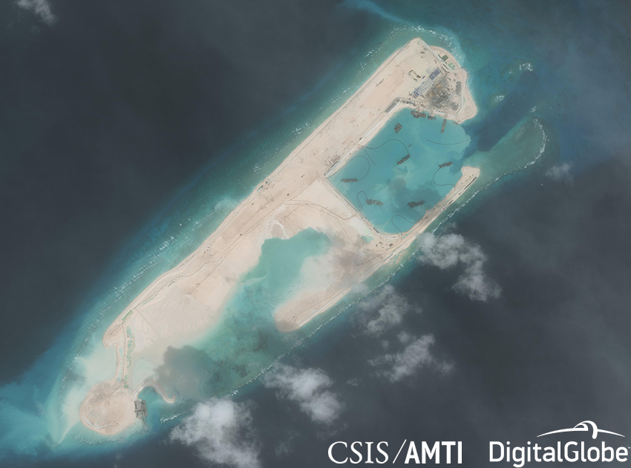
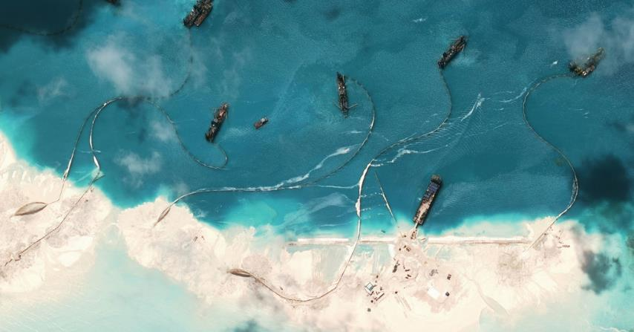
Notes:
Here is Fiery Cross Reef in January 2015.

Slide 19
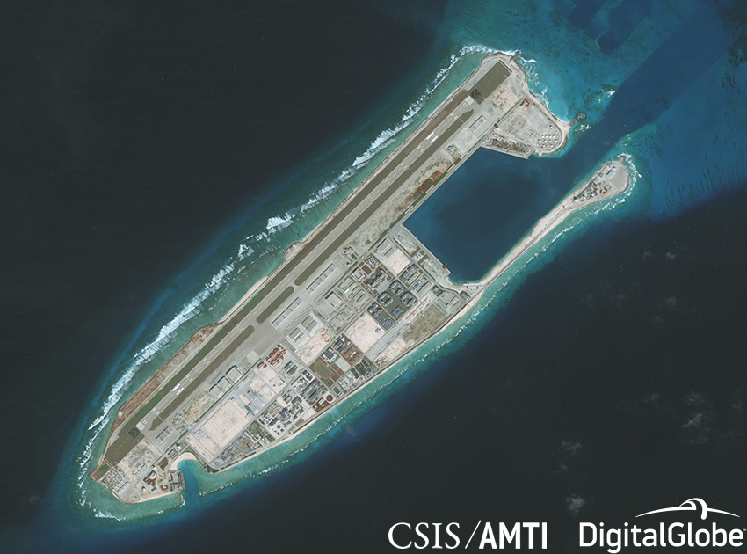
Notes:
Here is Fiery Cross in January 2018.

Slide 20
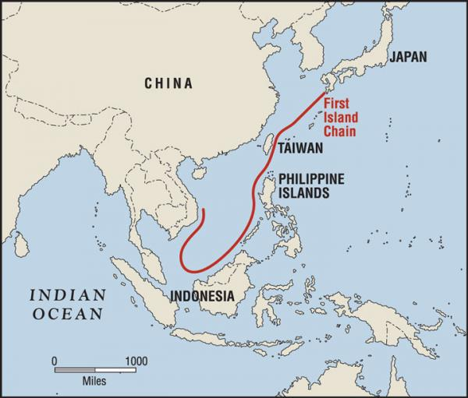
Notes:
Let’s start with placing the dispute in the context of U.S. – China relations, the Asia Pivot that Obama initiated, and the role the Philippines plays in the South China Sea. Of note here is the First Island Chain, which mirrors both China’s intentions of control, as well as U.S. intentions of preventing China from moving beyond this line of control. You can see that the countries that are geostrategically located right along the first island chain line, starting from the Ryuku island chain in Japan down, along Taiwan, the Philippine archipelago, then Malaysia and the South China Sea.

Slide 21
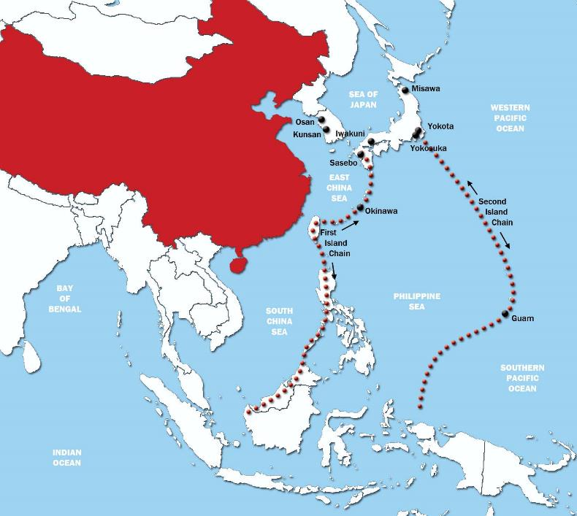
Notes:
Here is the Second Island Chain, where China would like to expand its influence to, with its increasingly effective “blue water navy,” countering or balancing against U.S. naval presence in the region. You can see from this map the locations of U.S. bases, and again the location of the Philippines in between these two lines of control.

Slide 22
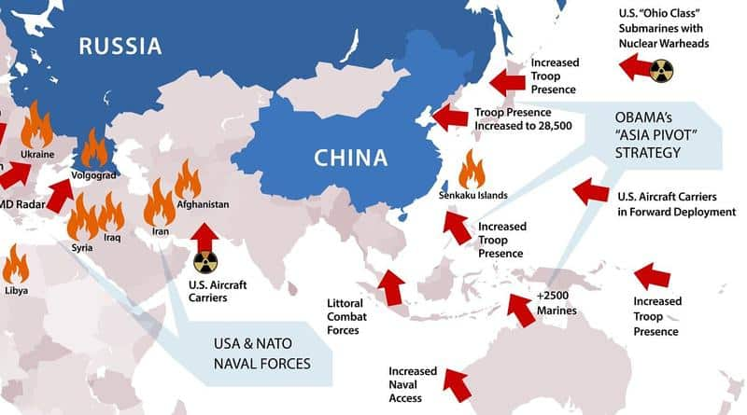
Notes:
This dispute is a useful way to discuss 1) great power politics, 2) realism at play, 3) alliances, 4) US national security, 5) international security, 6) US foreign policy, 7) international law
A brief primer on the Asia Pivot and US balancing against China’s growing influence in the Pacific: the Obama administration increased troop presence in Japan, South Korea, Guam, Australia, and the Philippines, despite the lack of bases in the Philippines, as well as naval and air force presence. From China’s perspective, you can see why China wants to balance against the US influence in the region and vice versa. This is a classic example of what we call in international relations as “security dilemma.”

Slide 23
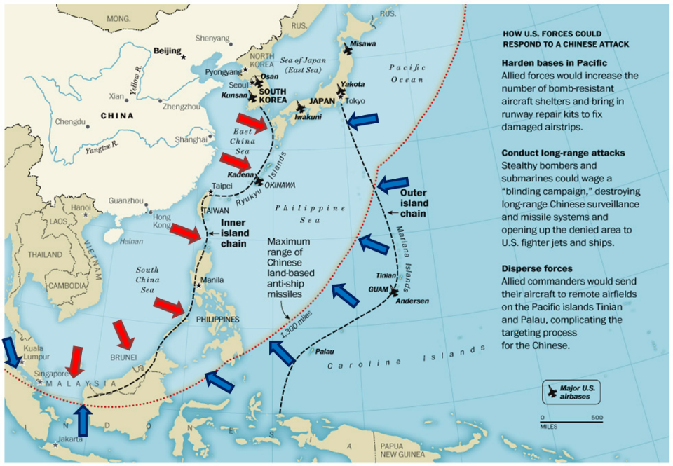
Notes:
Recent developments in the SCS and the broader context of East Asian security concerns: despite a verbal agreement in 2015 between President Obama and Premier Xi of China, China has continued militarizing built up islands
April – Chinese jammed equipment posted on “islands” to interfere with military communications and radar systems
Early May – reports that China has installed anti-ship cruise missiles and surface-to-air missiles on three fortified outposts in the Spratly Islands – this is a significant event because now China has further access beyond the second island chain
USFP – fairly ambiguous under Trump administration (focus is mostly on North Korea), mostly involving Freedom of Navigation Operations (FONOPS), not wanting to antagonize China and risk war, BUT this has been interpreted as tacit US approval of militarization; April 2018 – B-52 bombers flew across SCS in training mission, and a 60% increase in US troop participation in annual joint exercises in May 2018), but Duterte made clear these are not aimed at China
The Philippines remains squarely in the middle of this geostrategic game, and Pres Duterte is flip-flopping about relations with China and the US, and stalling about the issue

Slide 24
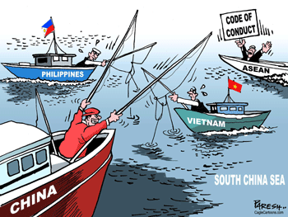
Notes:
The SCS sovereignty dispute is not going to be resolved any time soon and it may even be a fait accompli that China maintains control
To deal with the dispute, a working group based at CSIS has proposed code of conduct and cooperation on maritime scientific research, fisheries management, and oil/gas production, but this does not solve sovereignty problem

Slide 25
Questions & Discussion

