Slide 1
WVU’s Global Opportunities and Strategy: The Next Steps for Internationalization
Dr. William Brustein
Vice President for Global Strategies and International Affairs Eberly Family Distinguished Professor of History

Slide 2
Establishing the Global University
“A Global University is one in which international experiences and perspectives are fully integrated into the institution’s teaching and learning, research and discovery, and outreach and engagement mission.”

Slide 3
Establishing the Global University
Foundations of a Global University
Internationalization is perceived as value added to constituencies’ priorities
Internationalization is comprehensive including both intra- and extra-mural components
Internationalization requires commitment of university’s senior leadership
Internationalization is embedded in the institution’s culture – including strategic plans of all units and all majors
Internationalization is a means not an end

Slide 4
WVU’s 2020 Global Goals
Increase the international experience for undergraduate, graduate, and professional students.
Increase the percentage of international students and faculty and facilitate their integration into the campus community.
Increase international engagements and collaborations for faculty
Promote scholarship on major global issues.
Create and expand robust international partnerships.
Recognize international accomplishments in P&T processes.
Develop an international physical presence.
Promote collaboration with and support from WVU’s international alumni, globally-oriented West Virginia businesses and the local community.

Slide 5
Preparing Globally Competent Students (domestic and international students)
“Prepare students to comprehend and offer their perspectives, as well as design and implement solutions to the major global challenges of the 21st century.”

Slide 6
Preparing Globally Competent Students (domestic and international students)
How? Internationalize the teaching and learning experience to equip students with a global mindset, global knowledge and global skills
Awareness of and adaptability to diverse cultures, perceptions, and approaches
Familiarity with the major currents of global change and the issues they raise
Capacity for effective communication across cultural and linguistic boundaries
Ability to comprehend the international dimension of one’s field of study
Ability to work effectively in international settings

Slide 7
Preparing Globally Competent Students (domestic and international students)
The Global Mountaineers Certificate: “From Global Literacy to Global Competence”
Global enrichment within the major
Specific academic requirements as well as foreign language and education abroad
Capstone research/thesis/field project in major
Systematic evaluation in e-portfolio including self-reflection
Value added: notation on diploma, enhanced résumé for job prospects

Slide 8
Preparing Globally Competent Students (domestic and international students)
“Make education abroad accessible, affordable and high quality”
Remove curricular barriers
Reduce financial barriers: e.g., Capital Campaign, institutional investment and incentives, and student education abroad scholarship fee
Integrate education abroad into majors (e.g., IFTA, RAP, etc…)

Slide 9
Preparing Globally Competent Students (international students)
“It doesn’t end with recruitment”
Raise scholarship/fellowships for international students
Pre-Departure Orientations
International Student Life Workshops and Outreach Series (e.g., global engagement nights, global leadership initiative, global ambassadors, academic success workshops)
Cross cultural training for academic advisors, faculty and staff
Summer Intensive English Bridge Programs
Social activities (e.g., Taste of WVU, World Cup Soccer Tournament)
Career services support and job placement
WVU Global Portal Alumni Network

Slide 10
Internationalize Teaching and Research
Incentivize hiring of faculty with international teaching and research interest
Count faculty international teaching, research and engagement in P&T and annual reviews
Establish seed-grant programs (e.g., Global Portal grants, FAPESP)
Seek federal, corporate and foundation support (e.g., Title VI, Carnegie Corporation, State Department, USAID, World Bank, etc…)
Engage faculty in creation and implementation of university’s global goals and strategies (e.g., International Affairs Council {IAC}, Global Portal Advisory Committees)

Slide 11
Engaging the World: Bricks and Mortar vs. Global Portals
The Portal Model: “A portal to the world and the world’s portal to West Virginia”
Portal Features:
Locations based on significant connections
Low cost and flexible
Multi-purpose embassies facilitating teaching and learning, research and discovery and outreach and engagement

Slide 12
Global
Portals
Academic
Alumni Engagement
Corporate Partnerships
Faculty Teaching and Research
Institutional Partnerships
Dual Degrees
Education Abroad
Internships
Educational Intelligence
Capacity Building
Reconnecting Alumni to West Virginia University
Continuing Education
Alumni Club Formation
Development
Connections to Education, Business and Government
Assisting Companies with WV ties:
Career Services
Workforce Development
Research and Consulting

Slide 13
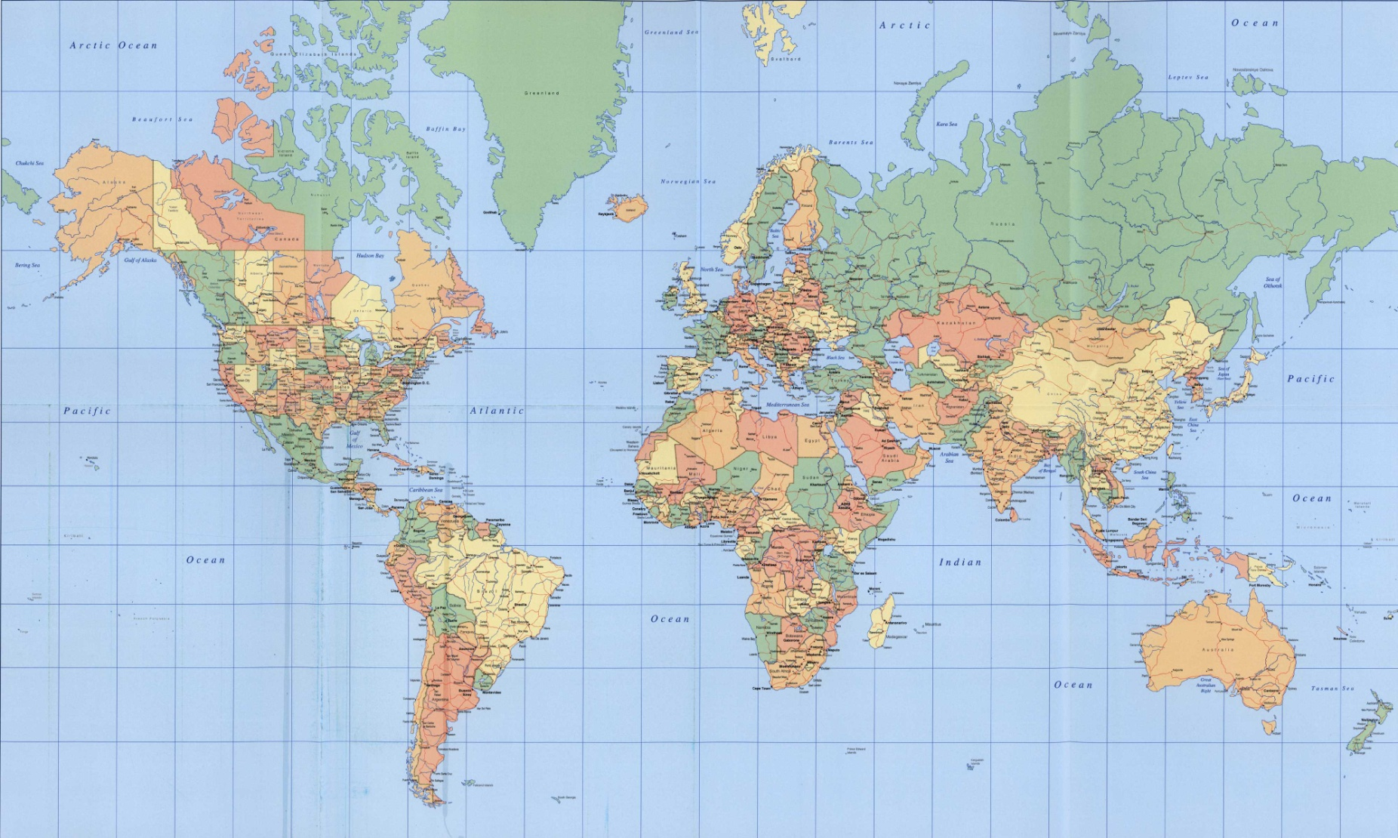
Portal Locations
Morgantown
China
Japan
Mexico
Bahrain
India
Malaysia
Mercosur
Current Portals
Future Portals

Slide 14
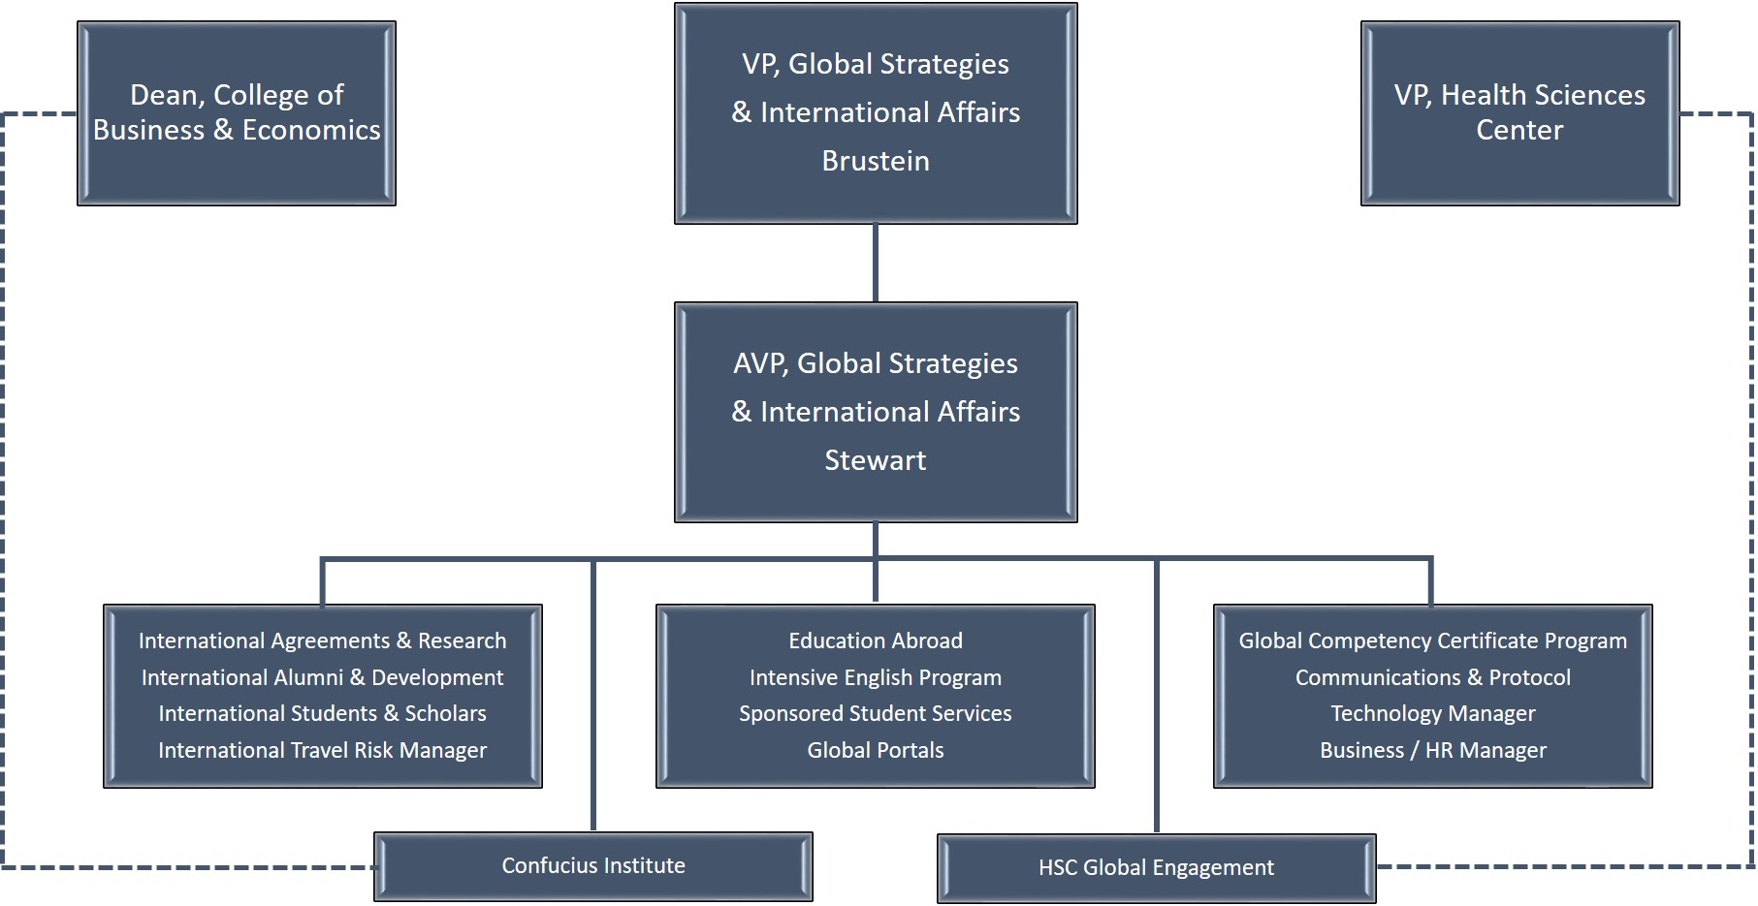
Office of Global Affairs Organization

Slide 15
Conclusion: Guiding Principles of OGA
Value proposition
Comprehensive
Strategic
Alignment
Entrepreneurial
Partnership

Slide 16
